Slide 1
Build Native Cross-Platform apps with .NET MAUI & Blazor Hybrid Workshop
Part 1 – Displaying Data

Slide 2
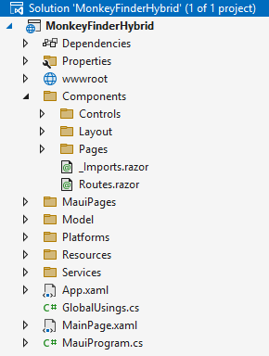
Project Structure
Blazor
1 single project that hosts all of the source code for the project including UI, platform code, shared resources, and more
MAUI
Notes:
Notice how the Blazor part is mostly Components. That is because everything in Blazor is a component. We’ll repeat that a couple of times more and see why that is a good thing and makes it easy to work with and reuse.

Slide 3
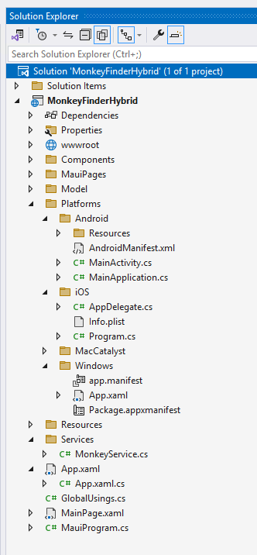
Platform Integration
Platform specific folders hold platform specific resources, configuration, startup logic, and platform code.

Slide 4
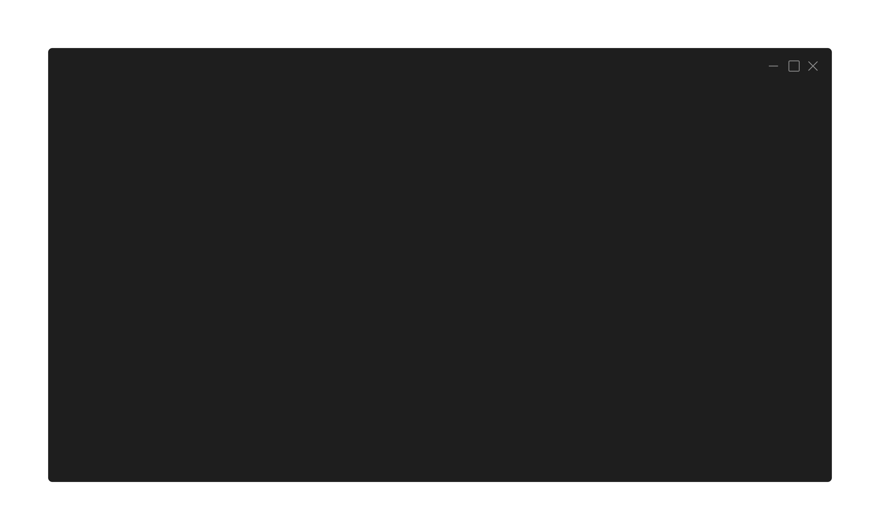
Multi-Targeted
<!-- Targeted Platforms -->
<TargetFrameworks>
net8.0-android;net8.0-ios;net8.0-maccatalyst;net8.0-windows10.0.19041
</TargetFrameworks>
<!-- Display name -->
<ApplicationTitle>MonkeyFinderHybrid</ApplicationTitle>
<!-- App Identifier -->
<ApplicationId>com.companyname.monkeyfinderhybrid</ApplicationId>
<!-- Versions -->
<ApplicationVersion>1</ApplicationVersion>
Notes:
From the single project you can target multiple platforms. To make your life a bit easier, we added some common properties for all platforms in the csproj file so you only have to set them once.

Slide 5
Blazor Hybrid/.NET MAUI Startup
public static MauiApp CreateMauiApp()
{
var builder = MauiApp.CreateBuilder();
builder
.UseMauiApp<App>()
.ConfigureFonts(fonts =>
{
fonts.AddFont("OpenSans-Regular.ttf", "OpenSansRegular");
});
builder.Services.AddMauiBlazorWebView();
#if DEBUG
builder.Services.AddBlazorWebViewDeveloperTools();
builder.Logging.AddDebug();
#endif
return builder.Build();
}
Notes:
The entry point for a Blazor Hybrid app is the MauiProgram.cs which has adopted the App Host Builder pattern.

Slide 6
Blazor Hybrid/.NET MAUI Startup (DI)
public static MauiApp CreateMauiApp()
{
var builder = MauiApp.CreateBuilder();
builder
.UseMauiApp<App>()
.ConfigureFonts(fonts =>
{
fonts.AddFont("OpenSans-Regular.ttf", "OpenSansRegular");
});
builder.Services.AddSingleton<MonkeyService>();
builder.Services.AddSingleton<IGeolocation>(sp => Geolocation.Default);
builder.Services.AddSingleton<MainPage>();
// Some code omitted for brevity return builder.Build();
}
Notes:
Dependency injection is built-in just like you are used to from ASP.NET

Slide 7
Blazor Hybrid Startup (MainPage.xaml)
<?xml version="1.0" encoding="utf-8" ?>
<ContentPage xmlns="http://schemas.microsoft.com/dotnet/2021/maui"
xmlns:x="http://schemas.microsoft.com/winfx/2009/xaml"
xmlns:local="clr-namespace:MonkeyFinderHybrid"
x:Class="MonkeyFinderHybrid.MainPage">
<BlazorWebView x:Name="blazorWebView" HostPage="wwwroot/index.html">
<BlazorWebView.RootComponents>
<RootComponent Selector="#app"
ComponentType="{x:Type local:Components.Routes}"/>
</BlazorWebView.RootComponents>
</BlazorWebView>
</ContentPage>
Notes:
The Blazor Hybrid app part is bootstrapped in the MainPage.xaml, index.html and Routes.razor, here you see the MainPage.xaml, notice how the BlazorWebView refers to the #app selector and the Components.Routes

Slide 8
Blazor Hybrid Startup (index.html)
<!DOCTYPE html>
<html lang="en">
<head><!-- Omitted for brevity --></head>
<body>
<div class="status-bar-safe-area"></div>
<div id="app">Loading...</div>
<div id="blazor-error-ui">
An unhandled error has occurred.
<a href="" class="reload">Reload</a>
<a class="dismiss">🗙</a>
</div>
<script src="_framework/blazor.webview.js" autostart="false"></script>
</body>
</html>
Notes:
Here is the index.html, notice the div with id=“app” that is where the Blazor app will be injected

Slide 9
Blazor Hybrid Startup (Routes.razor)
<Router AppAssembly="@typeof(MauiProgram).Assembly">
<Found Context="routeData">
<RouteView RouteData="@routeData" DefaultLayout="@typeof(Layout.MainLayout)" />
<FocusOnNavigate RouteData="@routeData" Selector="h1" />
</Found>
</Router>
Notes:
This is the Routes.razor file which maps all the available Blazor routes in the assembly and knows how to render a view

Slide 10
Part 1 – Displaying Data
https://aka.ms/blazor-hybrid-workshop

